Slide 1
Introduction of Blockchain and Crypto Assets By Dr. Norman Guo

Slide 2

The Origin of Blockchain
Other Crypto Assets
Blockchain and Bitcoin Basic

Slide 3
The Origin of Blockchain

Slide 4
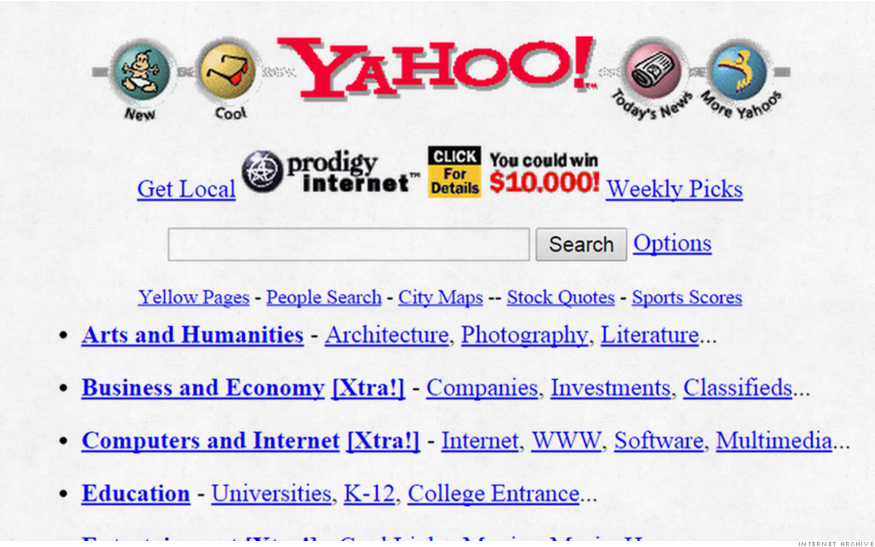
Internet of Information (Web 1.0)

Slide 5
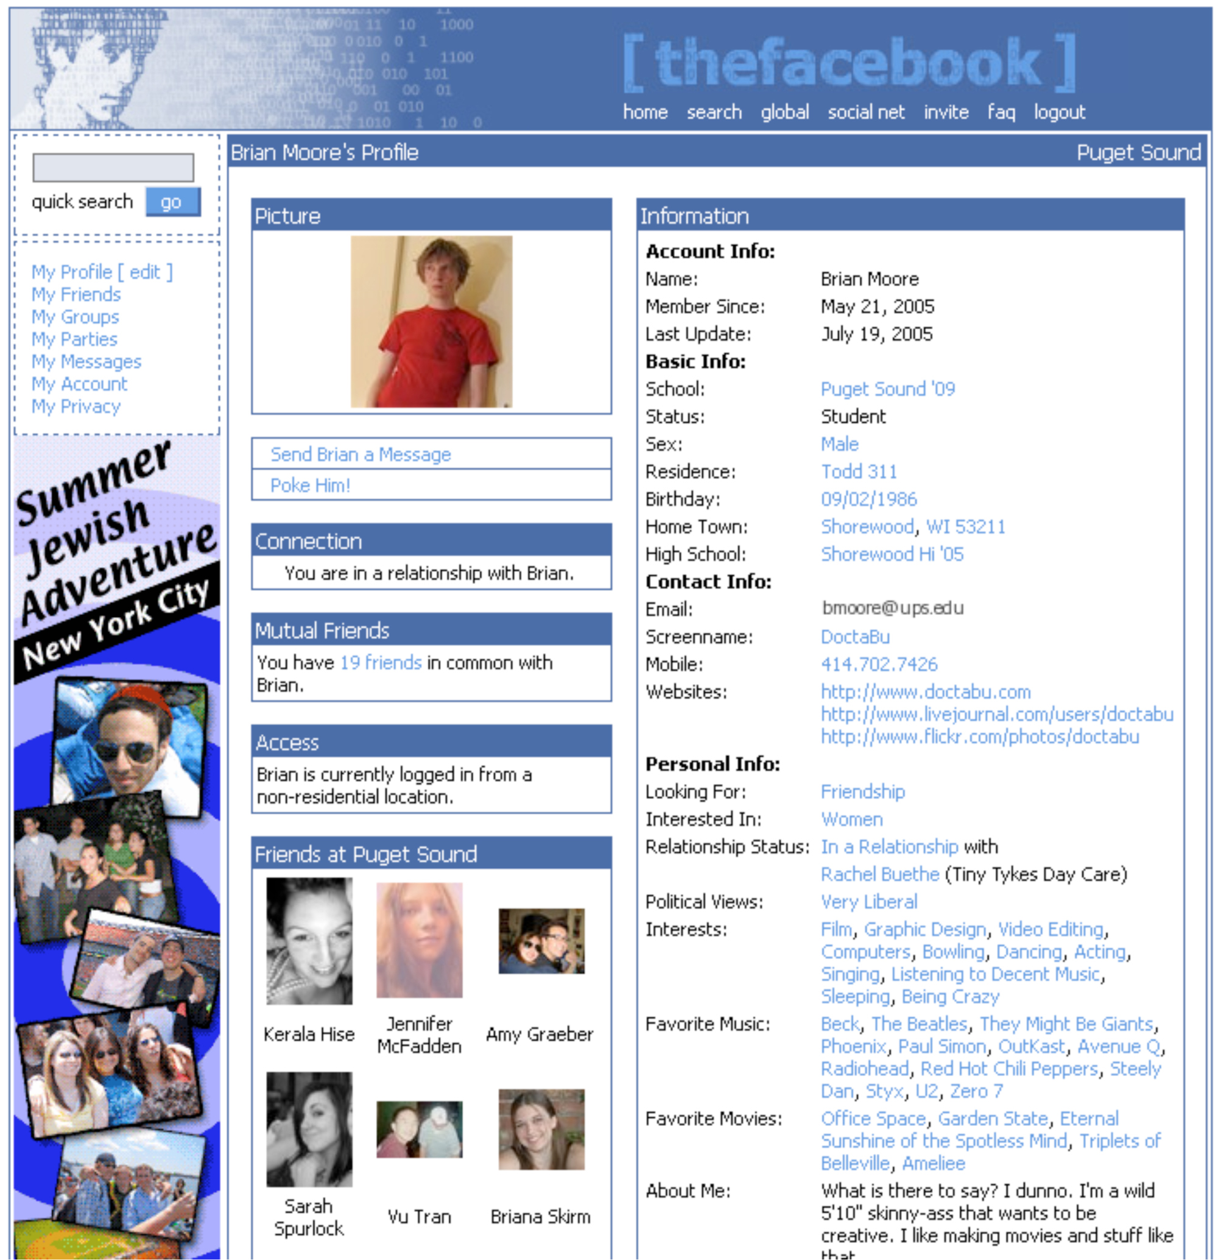
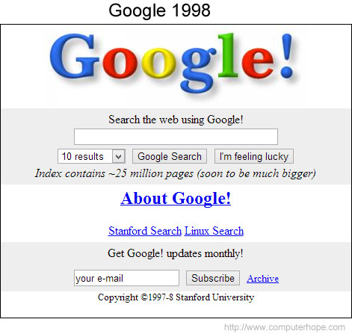
Internet of Information (Web 2.0)

Slide 6
Internet of Information
What is the concerns about such form of Internet?
Could you give us some examples?

Slide 7
Internet of Information
Limitation: Companies (banks or large tech companies) maintain its infrastructure and they extract a massive amount of data from us users
Exclusive
Data Privacy
Data Safety
Data Manipulation
Need a need protocol to regain the trust of information!

Slide 8
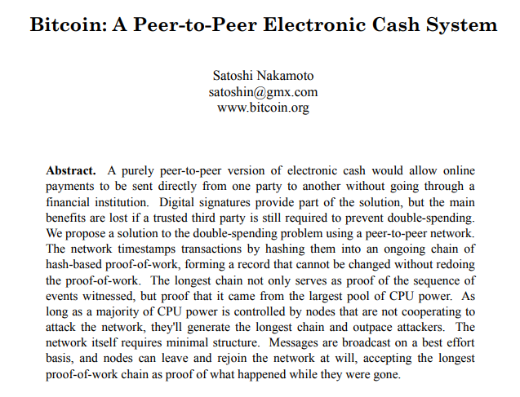
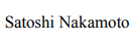
What is Blockchain
Released in October 2008
Anonymous

Slide 9
Blockchain and Bitcoin Basic

Slide 10
What is Blockchain
It’s a chain of block, or a digital distributed ledger
Basic Technologies
Hash Function
Digital Signature
Consensus mechanism

Slide 11
What is Blockchain
It’s a chain of block, or a digital distributed ledger
Basic Technologies
Hash Function
Digital Signature
Consensus mechanism

Slide 12
Blockchain Structure
Blockchain is a chain of blocks
Each block contains data, the hash, the hash of the previous block, and a pointer to the previous block
Prev. Hash
Prev. Hash
Prev. Hash
H( )
Data
Data
Data
Hash
Hash
Hash

Slide 13
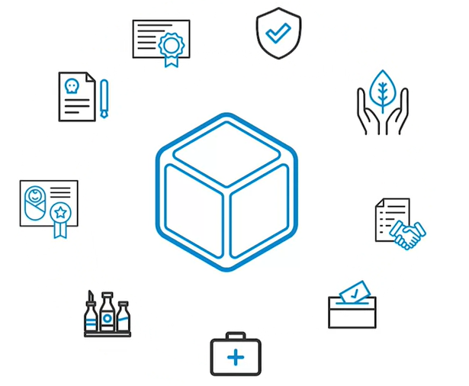
Blockchain Structure

Slide 14
What is Blockchain
It’s a chain of block, or a digital distributed ledger
Basic Technologies
Hash Function
Digital Signature
Consensus mechanism

Slide 15
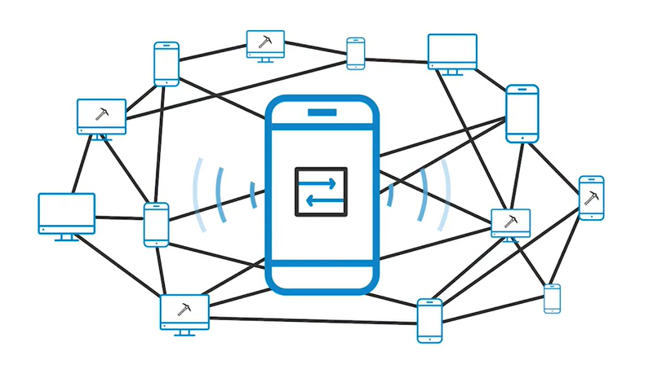
Blockchain is a Distributed Ledger

Slide 16
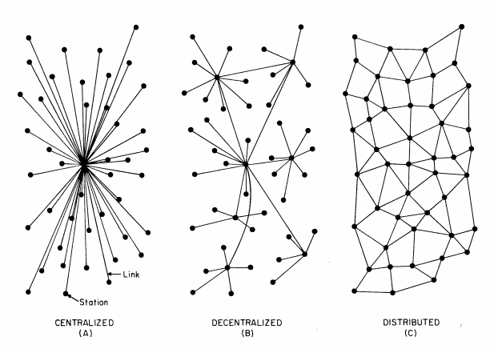
Blockchain is a Distributed Ledger

Slide 17
What is Blockchain
It’s a chain of block, or a digital distributed ledger
Basic Technologies
Hash Function
Digital Signature
Consensus mechanism

Slide 18
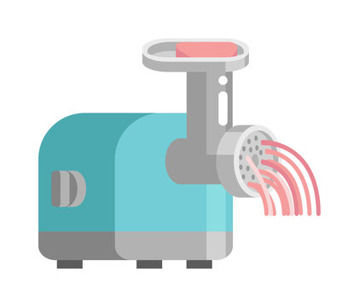
Blockchain Structure
The Hash Function: A “one-way” function
Alice sent Bob 2.5 bitcoins
SHA-256
f1e7decf894e3fd8eb182f247fa13bfe82a0d667d3c91fe8f307c3b43b329960
Demo

Slide 19
Blockchain is tamper-proof
If someone changes any part of a blockchain, then it is infeasible to make the chain consistent without changing the head pointer
One only need to check the head pointer to detect the tampering
Prev: H( )
Prev: H( )
Prev: H( )
Prev: H( )
H( )
Data
Data
Demo
Data
Data

Slide 20
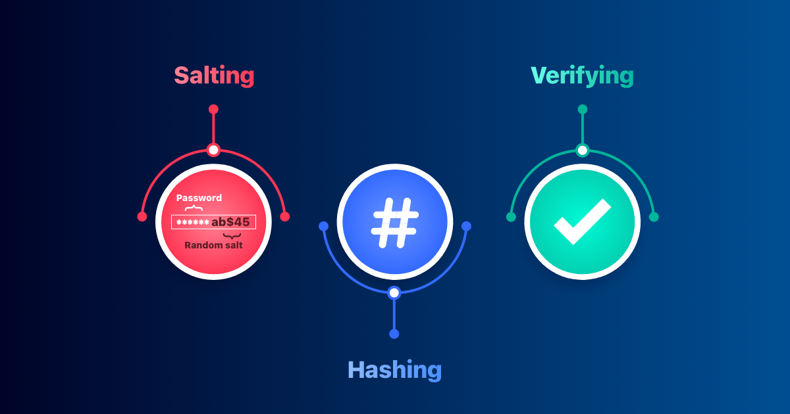
Applications of Hash Functions
Password Storage
Websites often store passwords of clients in hashed forms
When a customer enters a password, its hash will be compared with the stored hash for verification

Slide 21
What is Blockchain
It’s a chain of block, or a digital distributed ledger
Basic Technologies
Hash Function
Digital Signature
Consensus mechanism

Slide 22
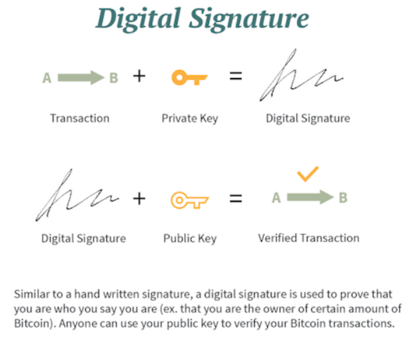
Digital Signature
Demo

Slide 23
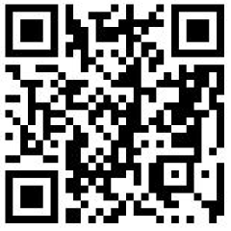
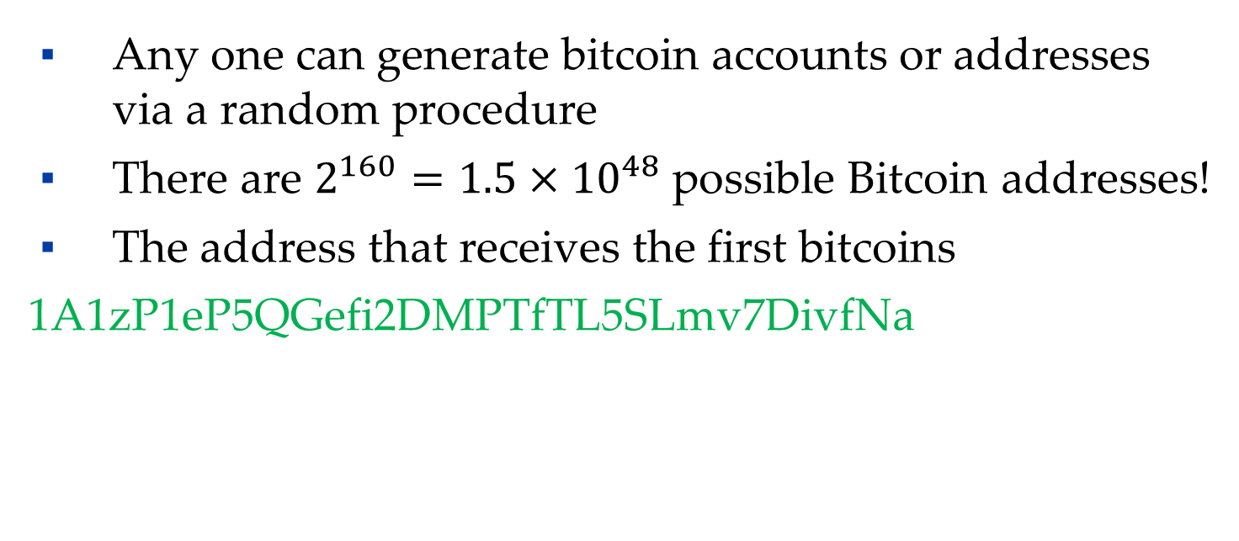
Bitcoin Addresses
Any one can generate bitcoin accounts or addresses via a random procedure
There are $2^{160}=1.5×{10}^{48}$ possible Bitcoin addresses!
The address that receives the first bitcoins
1A1zP1eP5QGefi2DMPTfTL5SLmv7DivfNa

Slide 24
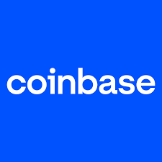
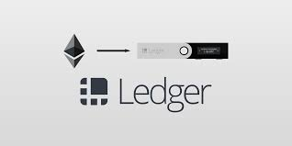

Bitcoin Wallets
Typically use wallet software to store bitcoins and the keys
Accounts at bitcoin exchanges, such as Coinbase.
Local Wallets
Desktop Computer or Mobile Device
Hardware Wallet

Slide 25
What is Blockchain
It’s a chain of block, or a digital distributed ledger
Basic Technologies
Hash Function
Digital Signature
Consensus mechanism

Slide 26
Consensus Mechanism
How do blockchain nodes agree like a big, happy family?
Proof of work (mining)
Proof of stake (staking)

Slide 27
Proof of Work
The miners compute the hash of block in progress together with a nonce, a fixed-length number
Source: King, Williams and Yanofsky (2013)

Slide 28
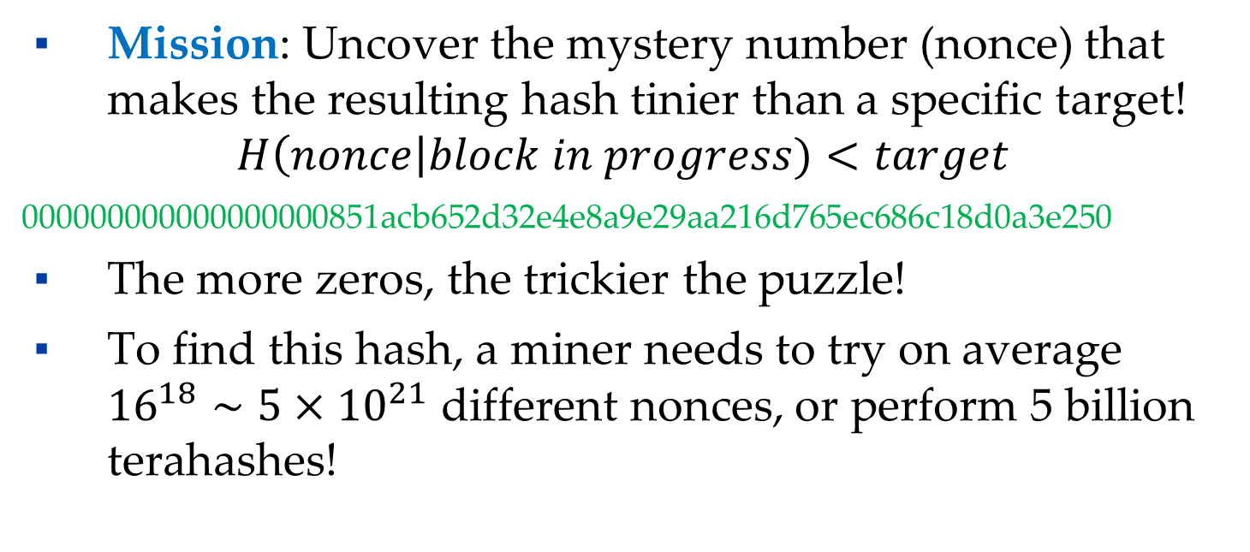
Proof of Work
Mission: Uncover the mystery number (nonce) that makes the resulting hash tinier than a specific target!
$$H\left(nonce\right|block in progress)<target$$
000000000000000000851acb652d32e4e8a9e29aa216d765ec686c18d0a3e250
The more zeros, the trickier the puzzle!
To find this hash, a miner needs to try on average ${16}^{18}∼5×{10}^{21}$ different nonces, or perform 5 billion terahashes!

Slide 29
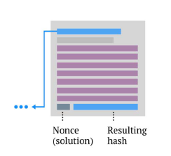
Proof of Work
When a miner finds a nonce that solves the problem, he/she wins the block and broadcasts the solution to the network
Demo

Slide 30

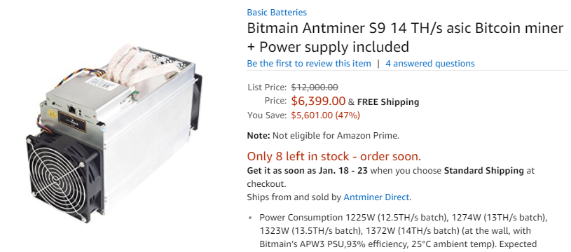
Evolution of Mining Hardware: Faster and More Specialized
More than the hash power of a general-purpose supercomputer!
CPU
GPU
FGPA
ASIC

Slide 31
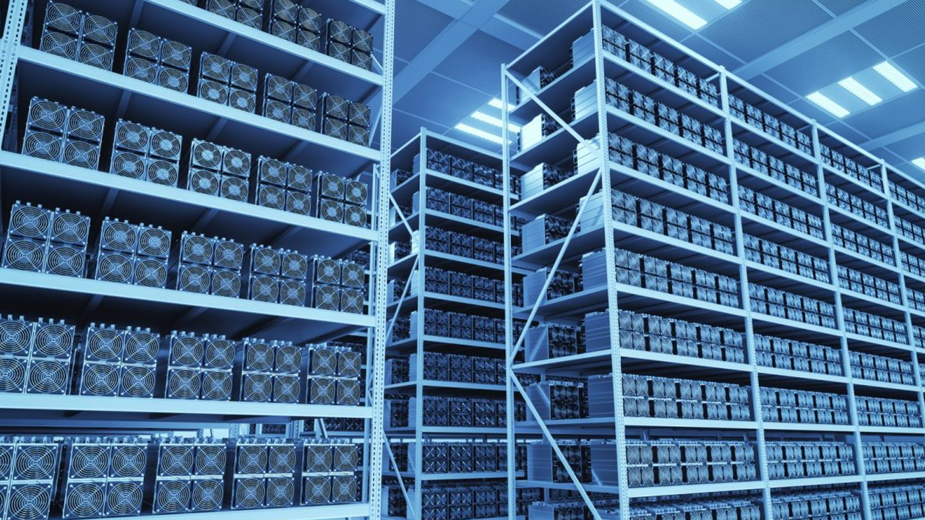
Evolution of Mining Hardware: Faster and More Specialized

Slide 32
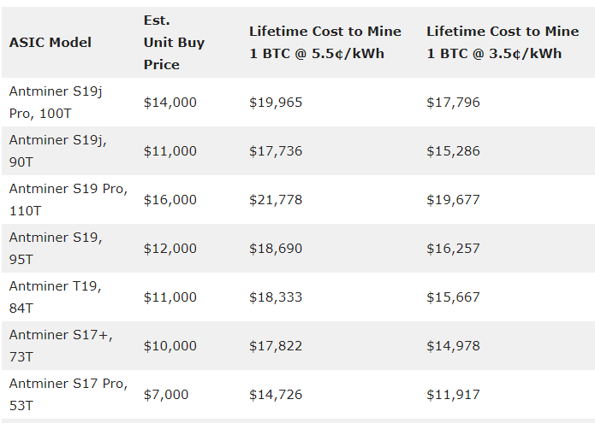
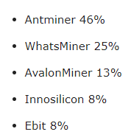
Evolution of Mining Hardware: Faster and More Specialized
market share per bitcoin mining machine manufacturer
Check the miner Calculator

Slide 33
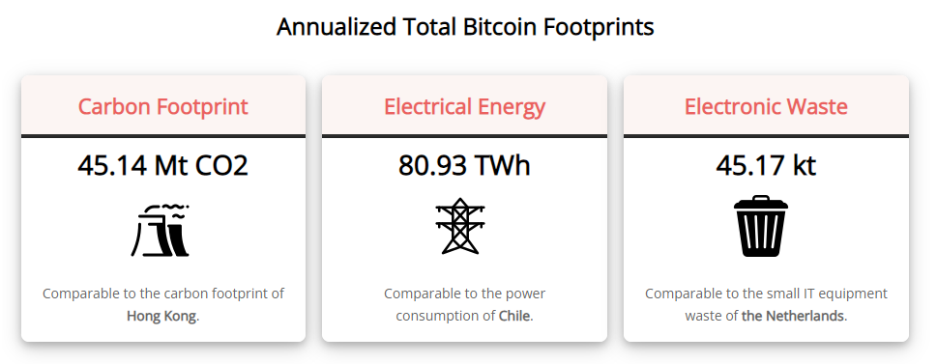
Challenge: Energy Consumed is Unsustainable
Energy Consumed is Unsustainable

Slide 34
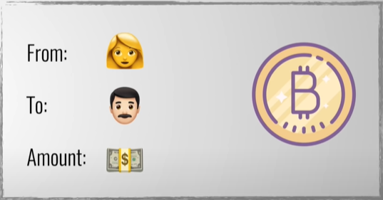
What is Bitcoin
Bitcoin is a cryptocurrency that store the transaction data of bitcoin on the blockchain system

Slide 35
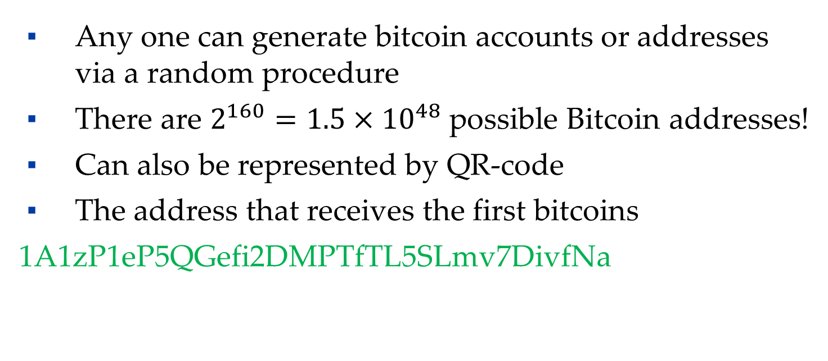
Bitcoin Addresses
Any one can generate bitcoin accounts or addresses via a random procedure
There are $2^{160}=1.5×{10}^{48}$ possible Bitcoin addresses!
Can also be represented by QR-code
The address that receives the first bitcoins
1A1zP1eP5QGefi2DMPTfTL5SLmv7DivfNa

Slide 36
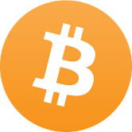
Bitcoin Transactions
Example: Alice finds irresistible goods from merchant Bob and sends him a shiny Bitcoin.
Alice
Bob
1 BTC

Slide 37
Bitcoin Transactions
Bob shares his public address with Alice via string or QR-code.
Alice enters Bob's address, the Bitcoin amount, and signs with her private key.
Alice broadcasts the transaction to the Bitcoin network—crypto magic!
Demo
Alice
Bob
1 BTC

Slide 38
Other Crypto Assets

Slide 39
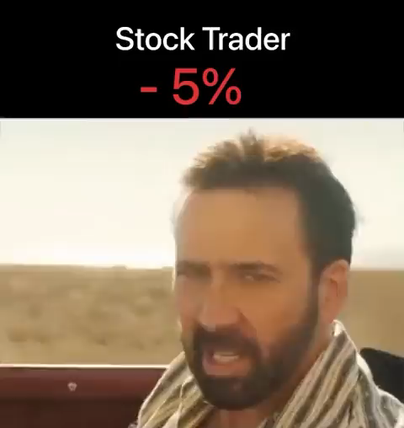
Crypto Investment 2022
Source: btctwitter

Slide 40
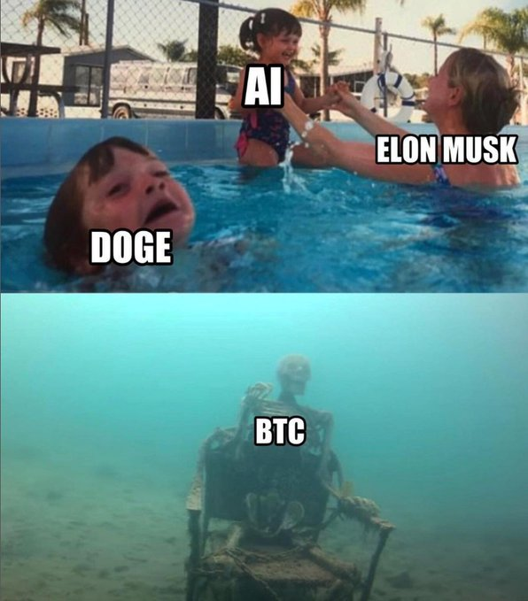
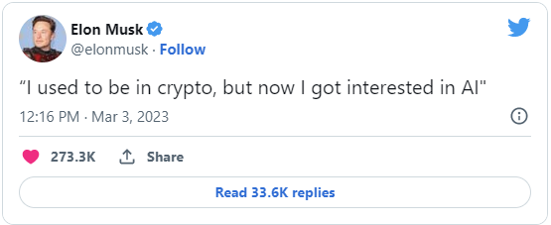
Elon Musk on Crypto

Slide 41
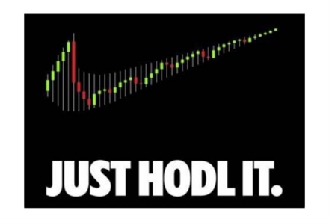
Others view on Crypto
When everything seems impossible, just HODL it
Source: trality.com

Slide 42
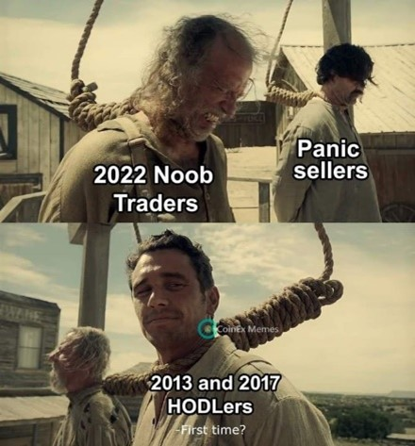
Others view on Crypto
“Believe me, I’ve been there. HODL,” says survivors of the 2013 and 2017 crypto crashes
Source: experty.io

Slide 43
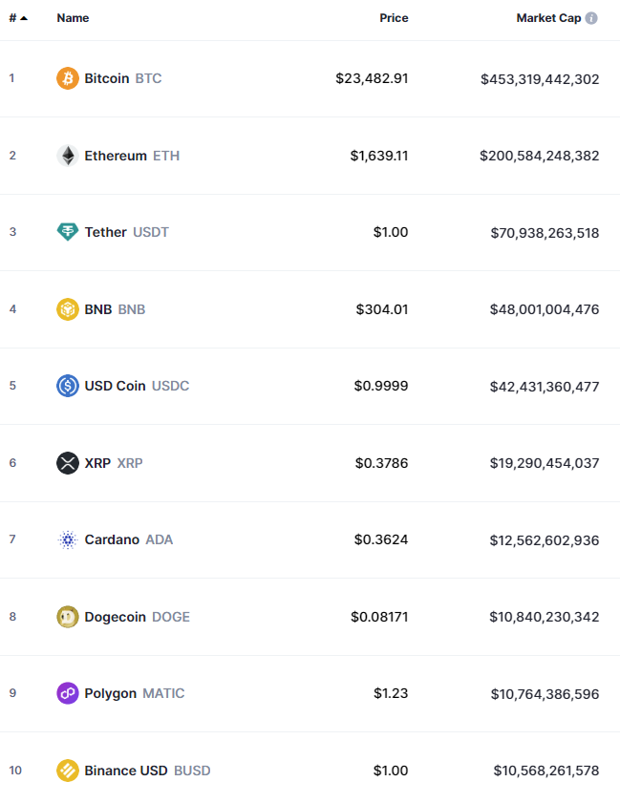
Top 10 Cryptocurrencies by Market Capitalization
Historical Trend
Current Rank

Slide 44
Cryptoasset Definition
A cryptoasset is a digital asset that uses cryptography, a peer-to-peer network, and a public ledger to do three things:
To regulate the creation of new units
To verify transactions
To secure these transactions without any middleman
-- Transaction on the blockchain: Don Tapscott and Alex Tapscott

Slide 45
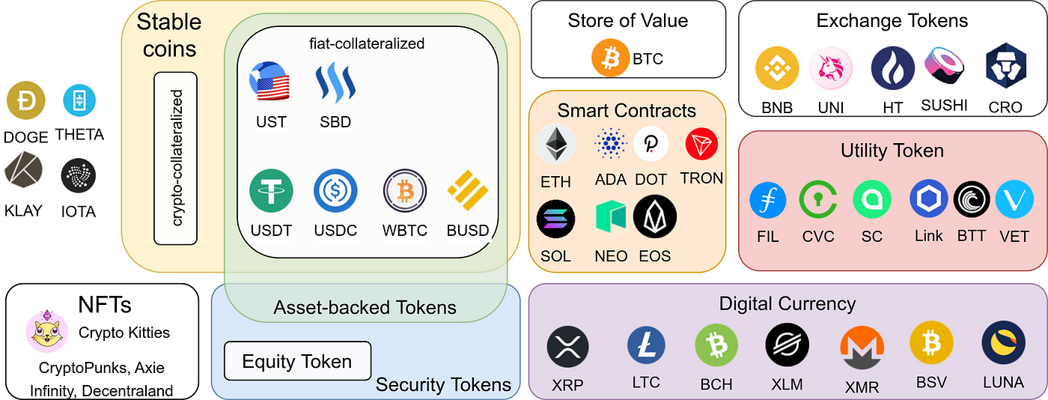
Types of Cryptoassets

Slide 46
Types of Cryptoassets
Payment Currencies
Platform Currencies
Tokens
Utility Tokens
Security Tokens
Crypto-collectibles (NFT)
Central Bank Digital Currencies & Stablecoins

Slide 47
Payment Currencies
A magical money form capturing global M1 & M2 money supply:
means of payment
store of value
Example
Bitcoin, Bitcoin Cash, Litecoin, Ripple’s XRP

Slide 48

Platform Currencies
Access & interact with super-cool blockchain platforms:
Native platform currency
Pay for goods & services in the ecosystem
Example
Ethereum, EOS, TRON

Slide 49

Ethereum
Founded by Vitalik Buterin in 2014
Cryptocurrency (Ether) and smart contract platform
Home base for countless ICOs
Home to thousands of decentralized applications (dApps) that cover finance, gaming, art, and more!

Slide 50
Tokens: Utility Tokens
Tokens with specific powers inside a blockchain platform:
Unlock special features or services
Incentivize user contributions
Example
BAT, GNT, MilkCoin

Slide 51

BAT
The fastest ICO
Brave Browser – Basic Attention Token (BAT):
Brave is a fast, open source, privacy-focused browser that blocks malvertisements, trackers, and contains a ledger system that anonymously captures user attention to accurately reward publishers.
On May 31st of 2017, Brave Browser launched its new digital currency, named the BAT. The ICO raised $36m via a token offering on the Ethereum Network. The offering raised 156,250 Ether in a mere 24 seconds!
The token can be used to obtain a variety of advertising and attention-based services on the Brave platform. The utility of the token is based on user attention, which simply means a person’s focused mental engagement
Notes:
https://basicattentiontoken.org/

Slide 52
Tokens: Security Tokens
Ownership tokens for underlying assets or financial instruments:
Issued via Security Token Offerings (STOs)
Example
tZERO's TZROP, Harbor's R-Token

Slide 53
Tokens: Crypto-collectibles (NFT)
Unique digital assets for digital or physical items:
Artwork, collectibles, or real estate
Built on platforms like Ethereum
Example:
CryptoKitties
Sandbox

Slide 54

Bored Ape Yacht Club
created by the Bored Ape Club
a collection of 10,000 unique 8-bit ape NFTs
Bored Ape Yacht Club #3749

Slide 55
Central Bank Digital Currencies
Digital currencies backed by central banks:
Greater financial inclusion
Speedy cross-border payments
Top-notch security
Efficient monetary policy

Slide 56
Stablecoin
Cryptos with stable value pegged to assets or fiat:
Minimize crypto volatility
Example
USDT, USDC, DAI

